Slide 1
Microsoft Virtual Events | Content Review

Slide 2
Meeting Agenda
Schedule and Resources
Program Overview
On24 Experience
Delivery Best Practices
Event Review

Slide 3
Microsoft Virtual Training Days
 | FY21 H1 Event Catalog
Azure | Microsoft Azure Virtual Training Day: Fundamentals Microsoft Azure Virtual Training Day: Migrating Server Infrastructure Microsoft Azure Virtual Training Day: Modernizing Web Applications and Data Microsoft Azure Virtual Training Day: Intelligent Decision Making Through Modern Data Warehousing*
Microsoft 365 | Microsoft 365 Virtual Training Day: Enable Remote Work with Microsoft Teams Microsoft 365 Virtual Training Day: Manage and Secure Access Microsoft 365 Virtual Training Day: Stop Attacks and Manage Risk Microsoft 365 Virtual Training Day: Building Microsoft Teams Integrations and Workflows
Biz Apps | Microsoft Dynamics 365 Virtual Training Day: Fundamentals Microsoft Power Platform Virtual Training Day: Fundamentals

Slide 4
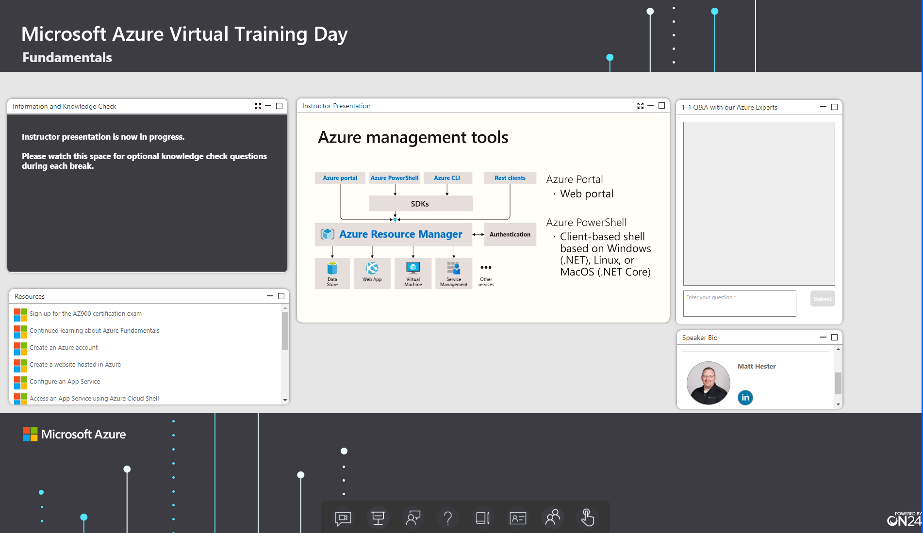
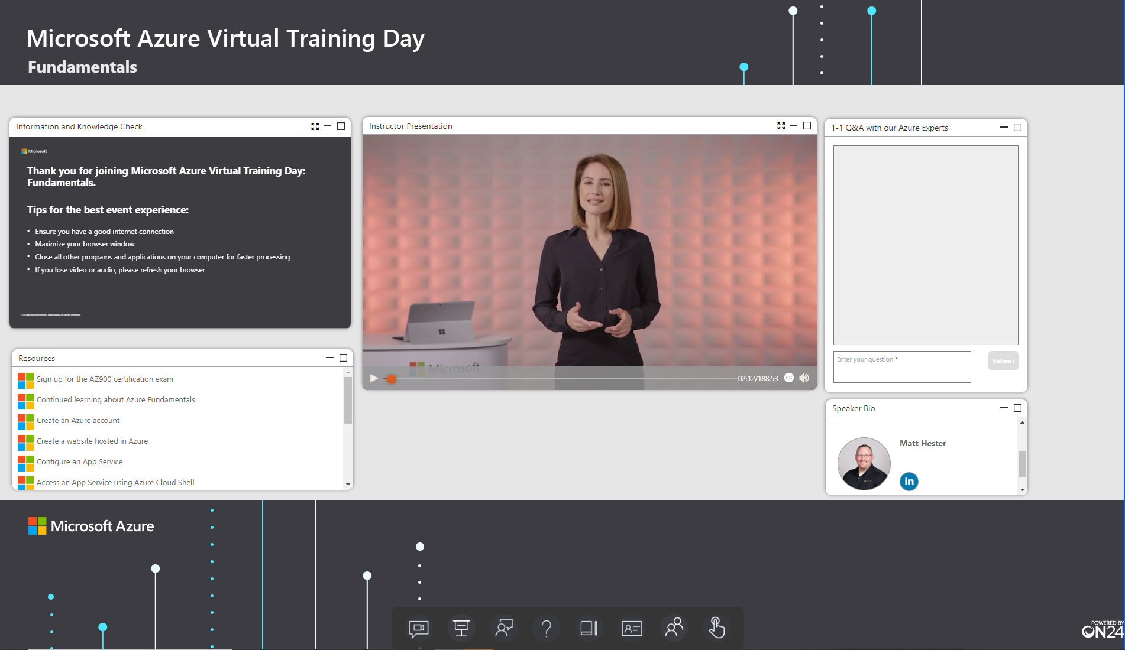
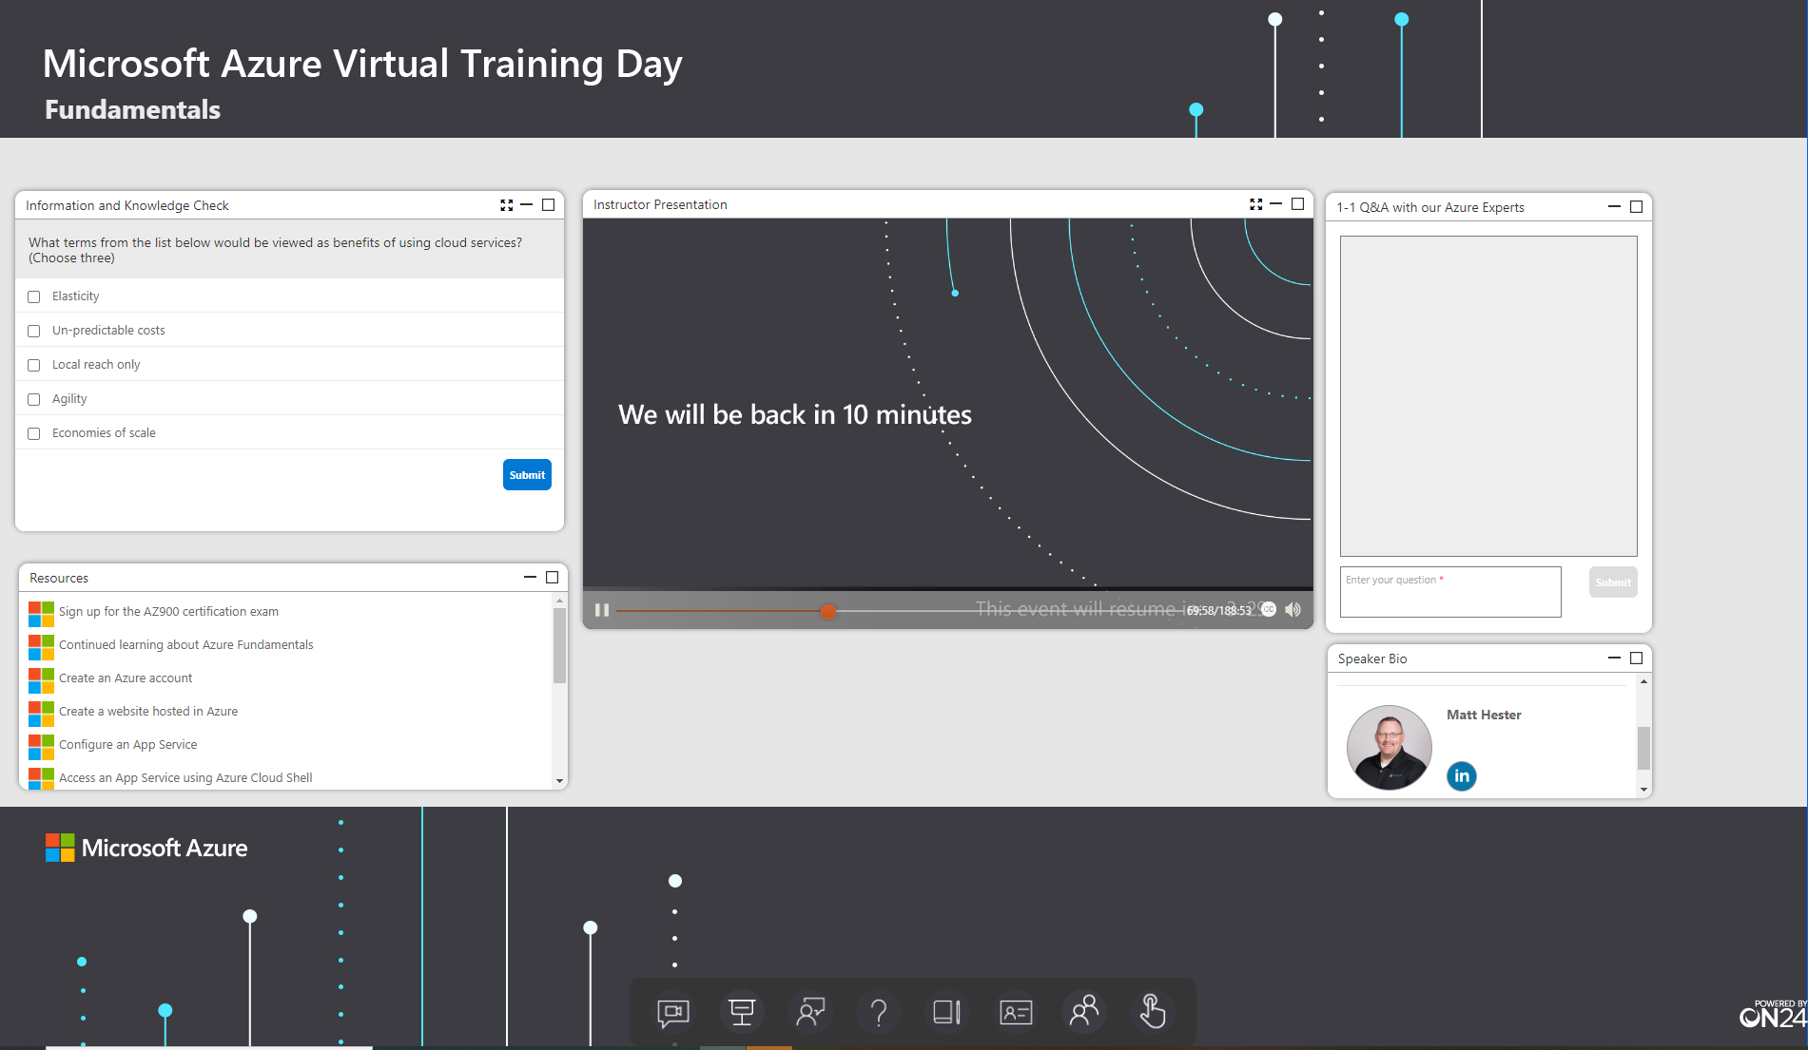
ON24 | Customer Experience
8
2
5
Information and Knowledge Check
Q&A
1
4
Resources
Media Player
Speaker Bio
3
6
7
Information and Knowledge Check
 | Tips for the best event experience
 | Information
 | Knowledge Check Poll
Media Player
 | Introduction with helpful tips
 | Event content
 | Break slide with countdown timer
Console Experience
 | Engagement Widgets/ Tools
 | Custom solution area branding
1
4
7
4
5
8
2
7
3
6

Slide 5
Best Practices
Keep in Mind | Pre/Post Actions
Recordings are for a global audience. | Prior to the recording: This is a global program. It is important to have consistency across all recordings. Do not edit or alter the presentation materials Do not reference day/time, geographical location, local events/holidays. Please have all your demo’s ready to be recorded. Demo set up can take and estimated 90 min. each We want this to be delivered like you were in front of a live audience! Be natural and keep the energy level up Check out your surroundings behind where you are recording and remove anything that could get on camera which you don’t want on camera or may be inappropriate for a global audience. Be sure to have the room you are doing the recording in set up the same way as you do during the Tech check
Recordings will be in market for 6 months to 1 year
Content is not shared with attendees
Attendees cannot access the demo environments | After the recording: You will receive the files back for editing and will have 2 days to review and comment on the recordings. Typically you receive the files back from WWL Studios about 4 – 7 days after completing the recording. You will receive an email from the Studios team with a link to the files which are located in Wipster. Wipster is a fun tool where you can view and put your comments right in the tool. This makes it easier for the editor to make the edits We are not looking to remove every “um” or “ah” but to call out areas where this is some major fixing required. The studios team does a really good job at the first round of edits prior to you seeing the content Please adhere to the review schedule! We have editors scheduled as well to complete the edits and put the course together. The entire schedule is delayed if we do not have the feedback in time.
Stay within the allotted session times.
Content cannot be edited.

Slide 6
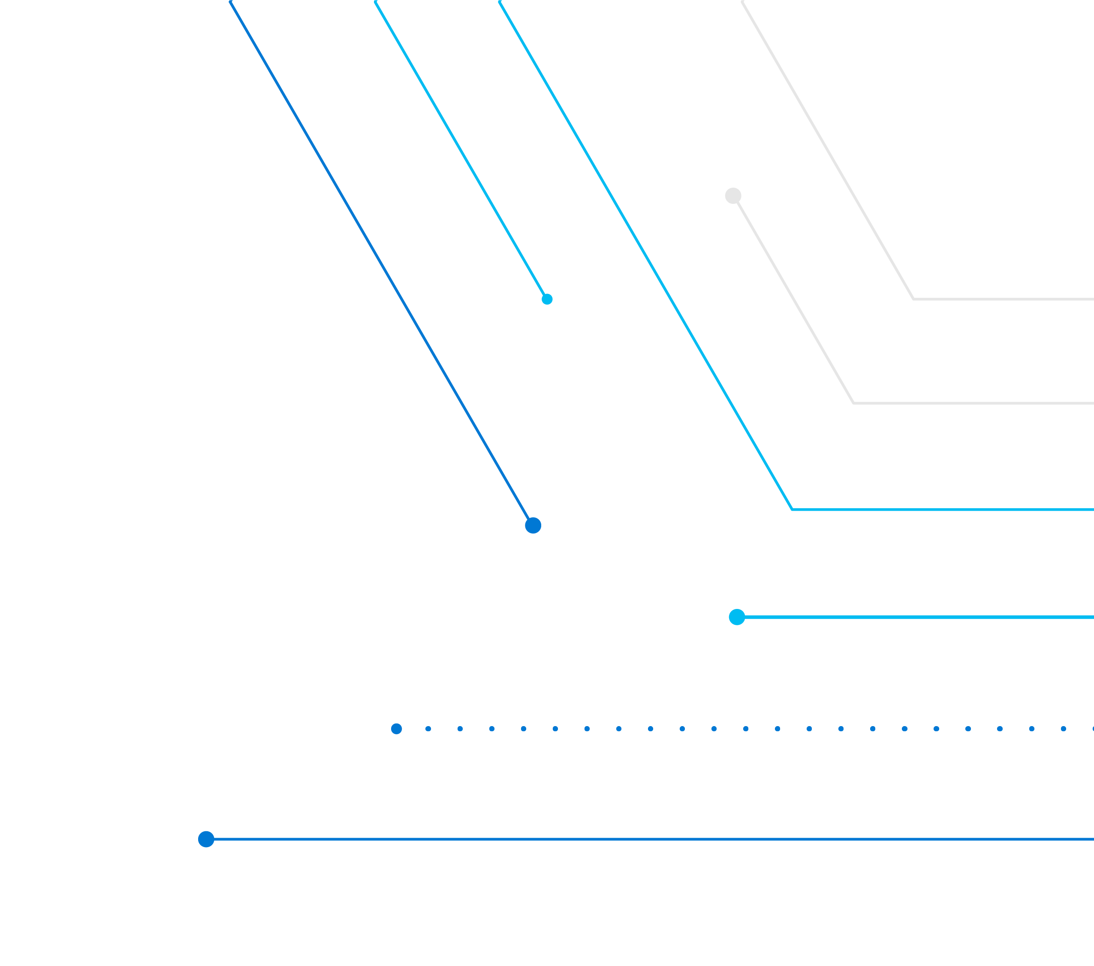
Microsoft 365 Virtual Training Day: Building Microsoft Teams Integrations and Workflows

Slide 7
Resources
Training Resources | Training Resources
Presentation decks | Please do not edit or alter the presentation slides
Demo Resources | Demo’s can take up to 90min to set up. Please ensure you have set up and run through the demo’s prior to recording Links are also included in the presentation NOTES of the demo title slides
Training Resource | English Recording-coming soon
Content/Demo Questions | Reach out to Julie DesCamp v-juldes@microsoft.com and Garrett Bundy gbundy@microsoft.com with any questions.

Slide 8
Microsoft 365 Virtual Training Day: Building Microsoft Teams Integrations and Workflows | Agenda
Part 1
Module Names​ | Duration ​
Introduction​ | 5 mins​
Implement Microsoft identity (Part 1) | 30 minutes
Break-10 minutes​ | 10 mins​
Implement Microsoft identity (Part 2) | 40 minutes
Break-10 minutes​ | 10 mins​
Work with Microsoft Graph | 35 minutes
Closing ​ | 10 mins​
TOTAL Duration of Recording 1​
Part 2
Module Names​ | Duration ​
Introduction​ | 5 mins​
Extend and customize SharePoint | 60 minutes
Break-10 minutes​ | 10 mins​
Extend Microsoft Teams | 60 minutes
Break- 10 mins | 10 mins​
Extend Office | 25 minutes
Closing ​ | 10 mins​
TOTAL Duration of Recording 2
Module recordings + Breaks, Introduction and Closing cannot exceed the total allotted event Part (1 or 2) time of 3:45min
Reach out to Julie DesCamp v-juldes@microsoft.com and Garret Bundy gbundy@microsoft.com with any questions regarding content or timing.

Slide 9
Agenda- Microsoft 365 Virtual Training Day: Building Microsoft Teams Integrations and Workflows
Demo links can be found in the notes section of each demo title slide and on the resources slide
Part 1
Module Names​
Module 1
Implement Microsoft identity (Part 1) Overview of the Microsoft identity platform Register an Application Demo: Registering an Application in Azure Active Directory
Module 2
Implement Microsoft identity (Part 2) Implement Authentication DEMO: Implementing Authentication Implement Authorization DEMO: Implementing authorization to consume an API
Module 3
Work with Microsoft Graph Overview of Microsoft Graph. Optimize data usage with query parameters. DEMO: Using query parameters when querying Microsoft Graph via HTTP Optimize network traffic. DEMO: Reducing traffic with batched requests Access user data with Microsoft Graph. DEMO: Querying user data from the Microsoft Graph Access files with Microsoft Graph. Manage a group lifecycle on Microsoft Graph.

Slide 10
Part 2
Module Names​
Module 4
Extend and customize SharePoint SharePoint Framework web parts. Demo: Intro to SharePoint Framework(SPFx) SharePoint Framework extensions. Demo: Creating SharePoint Framework Extensions Package and deploy a SPFx solution. Demo: Deploying a SharePoint Framework solution Consumption of Microsoft Graph and 3rd Party API’s Branding and theming in SharePoint
Module 5
Extend Microsoft Teams Microsoft Teams Apps Demo: Understanding the components of a Microsoft Teams App Webhooks in Microsoft Teams. Demo: Working with webhooks in Microsoft Teams Tabs in Microsoft Teams. Demo: Creating tabs in Microsoft Teams Messaging extensions in Microsoft Teams. Demo: Understanding messaging extensions in Microsoft Teams Conversational bots in Microsoft Teams. Teams + Power Platform Power Platform Overview Demo: Create a Power App from a SharePoint data source Teams + Power Platform Power Automate Overview Demo: Create a Flow using Power Automate
.

Slide 11
Part 2
Module Names​
Module 6
Extend Office- Office Add-ins. Demo: Understanding fundamental components and types of Office Add-ins Demo: Understanding Office JavaScript APIs Customization of Add-ins. Demo: Understanding customization of Add-ins Testing, debugging, and deployment options for Office Add-ins. Actionable messages. Demo: Understanding actionable messages
.

Slide 12
Intro/Outro Part 1
Description | Script
Course Intro / Module 1 Intro | Welcome to the Microsoft M365 Virtual Training Day: Building Microsoft Teams Integrations and Workflows. During this session, you will learn how to Implement Microsoft Identify and then how to work with Microsoft Graph. Lets get started! So, lets get started with Module 1
Module 1 - Outro to Break | Speaker to do a summary of the Module 1 content. Ending with " We will now take a 10 minute break. See everyone back here then when we will start Module 2"
Module 2 - Intro | Welcome back from the break! Speaker to do a quick introduction to module 2 Ending with "Lets get started with Module 2"
Module 2 - Outro to Break | Speaker to do a summary of the Module 2. Ending with " Let's take another 10 minute break. See everyone back here then to begin module 3!"
Module 3 - Intro | Welcome back from the break! Speaker to do a quick introduction to module 3 Ending with "Lets get started with Module 3"
Module 3 - Outro and Course Outro | "This concludes Par 1. Let's recap all the content that you have seen so far". Speaker to do a recap of the content covered. Ending with " Thank you for your attendance so far and we look forward to seeing you next time for Part 2 of this Microsoft M365 Virtual Training Day: Building Microsoft Teams Integrations and Workflows event !"

Slide 13
Intro/Outro Part 2
Description | Script
Part 2 Intro/Module 4 Intro | Welcome back to Part 2 for of Microsoft M365 Virtual Training Day: Building Microsoft Teams Integrations and Workflows. In this session, we will be covering the last three modules of the course. We will start with Extending and Customizing SharePoint, then move in to Extending Microsoft Teams, and finally discuss extending Office. Speaker to do a quick introduction to module 4 Ending with "So let's get started with Module 4"
Module 4 - Outro to Break | Speaker to do a summary of the Module 4. Ending with " Let's take a 10 minute break. See everyone back here then to begin module 5!"
Modul 5 - Intro | Welcome back from the break! Speaker to do a quick introduction to module 5 Ending with "Lets get started with Module 5"
Module 5 - Outro to Break | Speaker to do a summary of the Module 5. Ending with " Let's take a 10 minute break. See everyone back here then to begin module 6!"
Module 6 - Intro | Welcome back from the break! Speaker to do a quick introduction to module 6 Ending with "Lets get started with Module 6"
Module 6 - Outro and Course Outro | "This concludes our Microsoft M365 Virtual Training Day: Building Microsoft Teams Integrations and Workflows event. Let's recap all the content that you have seen. " Speaker to do a recap of the content covered (include both parts). Ending with "Thank you for attending and we hope you enjoyed these sessions. Remember there are many ways to continue your learning journey such as MSLearn where we offer self-paced learning options and be sure to check the calendar for more Microsoft Virtual Training Day Events as well."

Slide 14
Show Flow Part 1
MVTD Recording |Microsoft M365 Virtual Training Day: Building Microsoft Teams Integrations and Workflows event
Seg # | Duration | Segment | Speakers | Timer | Visuals | Notes / Details
6:30 | 0:00:00
1 | 0:02:00 | Event Begins Shortly |  | 2 Minutes | Slate w/ Timer | 2 Minute timer with opening slate
2 | 0:01:00 | On24 Platform Intro Video | Australian Video or VO | 1 Minute | Pre-Record | (Timing depends on VO or AUS Video)
3 | 0:02:00 | Course Intro / Module 1 Intro | <presenter> | 5 Minutes | On Camera
4 | 0:30:00 | Module 1- Implement Microsoft Identity (Part 1) | <presenter> | 30 Minutes | Desktop Share
5 | 0:02:00 | Module 1 - Outro to Break | <presenter> | 2 Minutes | On Camera
6 | 0:10:00 | Break |  | 10 Minutes | Slate w/ Timer | 10 Minute timer with branding match to slate
7 | 0:02:00 | Module 2 - Intro | <presenter> | 2 Minutes | On Camera
8 | 0:40:00 | Module 2 - Implement Microsoft Identify (Part 2) | <presenter> | 40 Minutes | Desktop Share
9 | 0:02:00 | Module 2 - Outro to Break | <presenter> | 2 Minutes | On Camera
10 | 0:10:00 | Break |  | 10 Minutes | Slate w/ Timer | 10 Minute timer with branding match to slate
11 | 0:02:00 | Module 3 - Intro | <presenter> | 2 Minutes | On Camera
12 | 0:32:00 | Module 3 - work with Microsoft Graph | <presenter> | 32 Minutes | Desktop Share
18 | 0:05:00 | Module 3 - Outro and Part 1 outro | <presenter> | 5 Minutes | On Camera | lower third with https://docs.microsoft.com/learn
19 | 0:30:00 | Closing Slate |  | 30 Minutes | Slate | Closing Slate (no Timer, reduce timing as appropriate to ensure that total time remains at or below 4 hours total)

Slide 15
Show Flow Part 2
MVTD Recording |Microsoft M365 Virtual Training Day: Building Microsoft Teams Integrations and Workflows event
Seg # | Duration | Segment | Speakers | Timer | Visuals | Notes / Details
6:30 | 0:00:00
1 | 0:02:00 | Event Begins Shortly |  | 2 Minutes | Slate w/ Timer | 2 Minute timer with opening slate
2 | 0:01:00 | On24 Platform Intro Video | Australian Video or VO | 1 Minute | Pre-Record | (Timing depends on VO or AUS Video)
3 | 0:02:00 | Course Intro / Module 4 Intro | <presenter> | 5 Minutes | On Camera
4 | 1:00:00 | Module 4- Extend and customize SharePoint | <presenter> | 60 Minutes | Desktop Share
5 | 0:02:00 | Module 4 - Outro to Break | <presenter> | 2 Minutes | On Camera
6 | 0:10:00 | Break |  | 10 Minutes | Slate w/ Timer | 10 Minute timer with branding match to slate
7 | 0:02:00 | Module 5 - Intro | <presenter> | 2 Minutes | On Camera
8 | 1:00:00 | Module 5 - Extend Microsoft Teams | <presenter> | 60 Minutes | Desktop Share
9 | 0:02:00 | Module 5 - Outro to Break | <presenter> | 2 Minutes | On Camera
10 | 0:10:00 | Break |  | 10 Minutes | Slate w/ Timer | 10 Minute timer with branding match to slate
11 | 0:02:00 | Module 6 - Intro | <presenter> | 2 Minutes | On Camera
12 | 0:24:00 | Module 6 - Extend Office | <presenter> | 24 Minutes | Desktop Share
18 | 0:05:00 | Module 6 - Outro and event wrap up | <presenter> | 5 Minutes | On Camera | lower third with https://docs.microsoft.com/learn
19 | 0:30:00 | Closing Slate |  | 30 Minutes | Slate | Closing Slate (no Timer, reduce timing as appropriate to ensure that total time remains at or below 4 hours total)

